Slide 1
Identifying fake news in facebook
Marc Nares
Aleo De Leon
Wyatt Holgado
Joshua Cruz

Slide 2
Our Project
In this project we will create a model that identifies if a link posted on Facebook leads to an article that is fake or not. We will use SVM algorithm for classifying the link and it will be implemented through a web extension that will only run on Facebook.

Slide 3
Purpose of this project
The purpose of this project is to prevent online users from being tricked by fake news

Slide 4
The problem
Fake news misleads people and make the world less informed.
It harms the community and the industry in an alarming level.
Eric Trump, the son of Donald Trump, tweeted an article about paid protestors from the domain “abcnews.com.co” that reinforced right wing conspiracy theories. The article was completely fabricated, but it resembled the real ABC News enough to fool those who weren’t paying attention

Slide 5
Our objectives
To create a classification model that determine whether a link leads to a fake news article or not.
To create a web extension for Facebook that can identify whether a link clicked by a user leads to a fake news article or not.

Slide 6
Scope and limitation
We will use JavaScript programming language to create a web extension for identifying fake news.
The gathered datasets will come from three online websites (Kaggle.com, cbcpwebsite.com, Primer.com).
The extension will only work on the latest and upcoming versions Google Chrome and it will not work on any other browsers.
This study is only limited on identifying fake news in Facebook and will not cover any microblogging sites.
The researchers will not use any classifier algorithm other than SVM.

Slide 7
What is Support Vector Machine
A Support Vector Machine (SVM) is a supervised machine learning algorithm that can be employed for both classification and regression purposes.

Slide 8
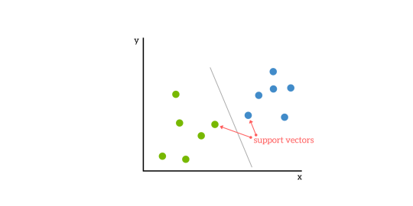
How SVM works
SVMs are based on the idea of finding a hyperplane that best divides a dataset into two classes

Slide 9
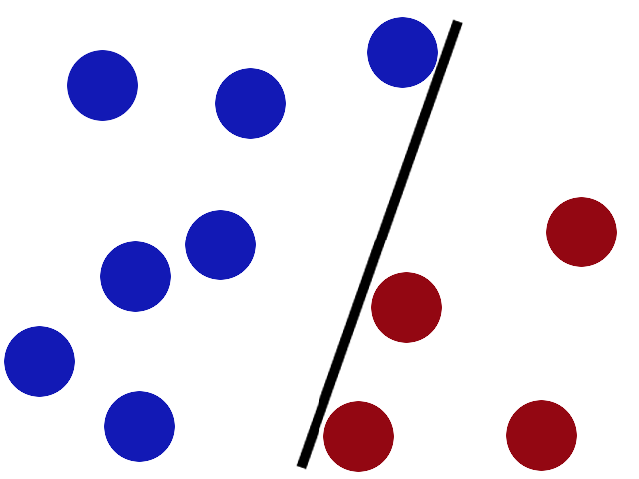
How SVM works
Hyperplane is a line that linearly separates and classifies a set of data.

Slide 10
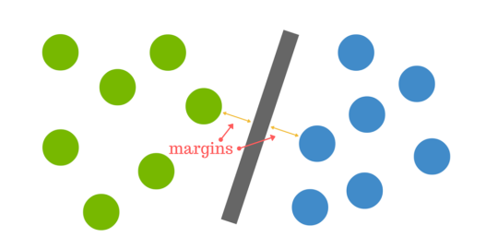
How do we find the right hyperplane
The distance between the hyperplane and the nearest data point from either set is known as the margin.
The goal is to choose a hyperplane with the greatest possible margin between the hyperplane and any point within the training set, giving a greater chance of new data being classified correctly.

Slide 11
Design of the project
The researchers will create a web extension that can identify fake news and will only run if the link is clicked in Facebook
The extension will be developed using HTML, CSS, PHP and JavaScript and it will be compatible to Google Chrome.
When the link is clicked, the system will compare the news link article from the list of fake news links and from the list of authentic news gathered by the team.
If the link is not in the list, the system then will get the data from the link to compare the following:
author: if there is an author
title: unusual formatting
site_url : link
likes: number of Facebook likes
comments: number of Facebook comments
shares: number of Facebook shares

Slide 12
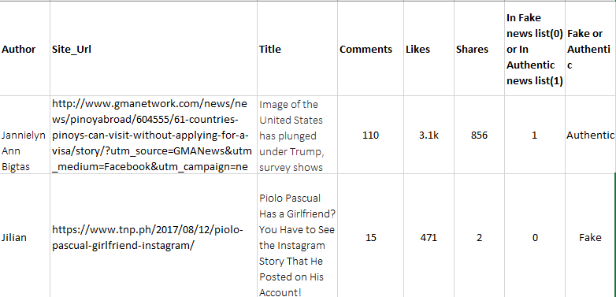
Design of the project

Slide 13
Design of the project
After comparing the link and confirming it the data will be saved to database for future preference.
If the author is unknown the system will automatically flagged it as fake.
If the link is confirmed fake the system will notify the user with a dialog box popped up, but if the link article is authentic the system will also notify the user.

Slide 14
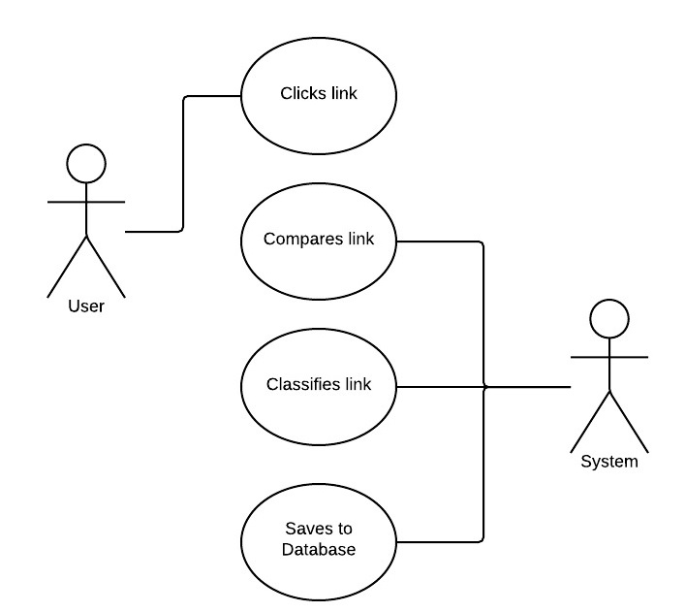
Use Case Diagram

Slide 15
Use Case Full Description
Use Case | Clicks the link
Actor: | User
Description | The user clicks the link in his/her Facebook newsfeed.
Flow of Events | User clicks the link. The system runs. Use case ends.
Pre-condition | The user should click the link.
Post-condition | The system will run

Slide 16
Use Case Full Description
Use Case: | Comparing detected link
Actor: | System
Description: | The system will compare the detected links.
Flow of Events: | The system request data from database The system compares the detected link to the list of fake/authentic news in database. Use case ends.
Pre-Condition: | The user should click the link.
Post-Condition: | The system compared the detected link.

Slide 17
Use Case Full Description
Use Case: | Classifying detected link
Actor: | System
Description: | The system will classify the detected links.
Flow of Events: | User clicks the link The system will classify whether the compared link is fake or not. Use case ends.
Pre-Condition: | The system should compare the link.
Post-Condition: | The system classified the detected link.

Slide 18
Use Case Full Description
Use Case: | Save to database
Actor: | System
Description: | The system will save the classified link to the database.
Flow of Events: | The system will save the classified link in database Use case ends.
Pre-Condition: | The system must classify the link
Post-Condition: | The system saves the classified link to the database.

Slide 19
Event Table
Event | Trigger | Source | Use Case | Response | Destination
User clicks the link | link was clicked | User | Clicks link | System runs | System
System compares link | System compares the link | System | Compares link | System compares the link to the list of fake news links | System
System classifies the link | System classifies the link | System | Classifies link | System classifies the link | System
System saves to database | System saves to database | System | Saves to database | The classified link is saved to database | Database

Slide 20
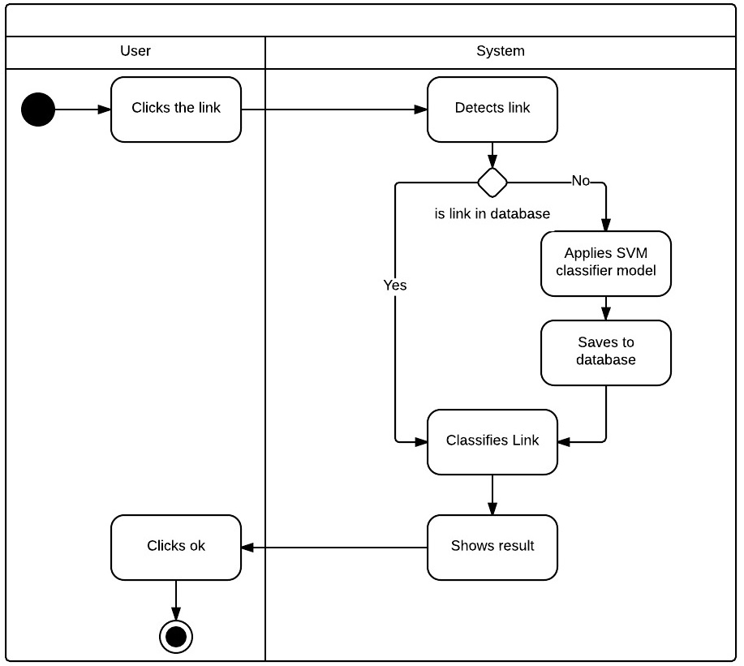
Activity Diagram

Slide 21
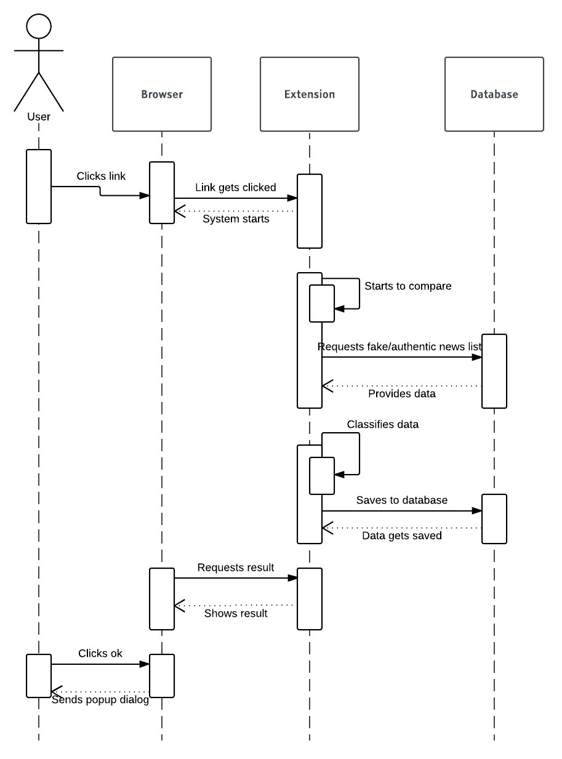
Sequence Diagram

Slide 22
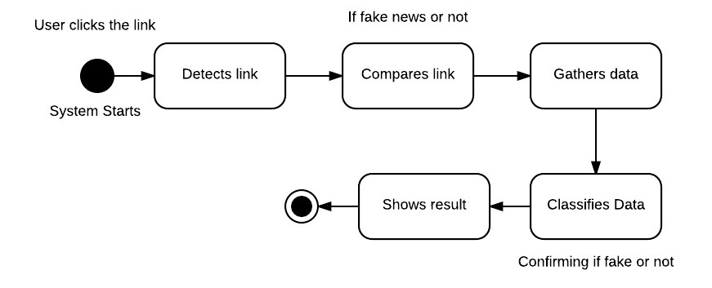
State Diagram

Slide 23
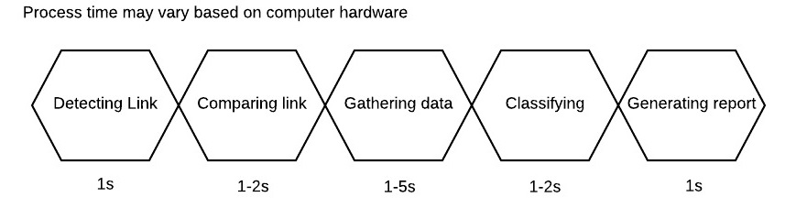
Timing Diagram

Slide 24
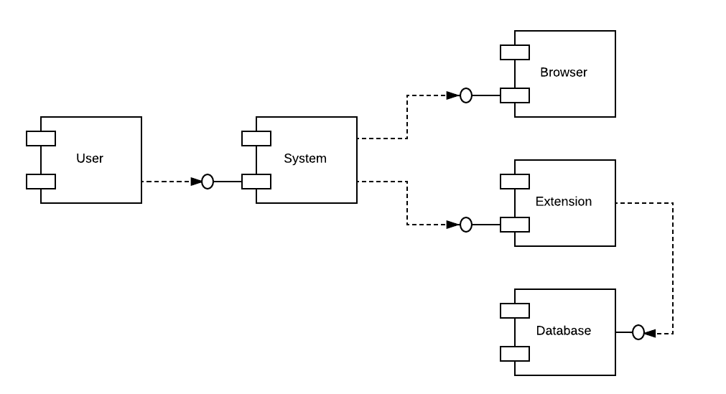
Component Diagram

Slide 25
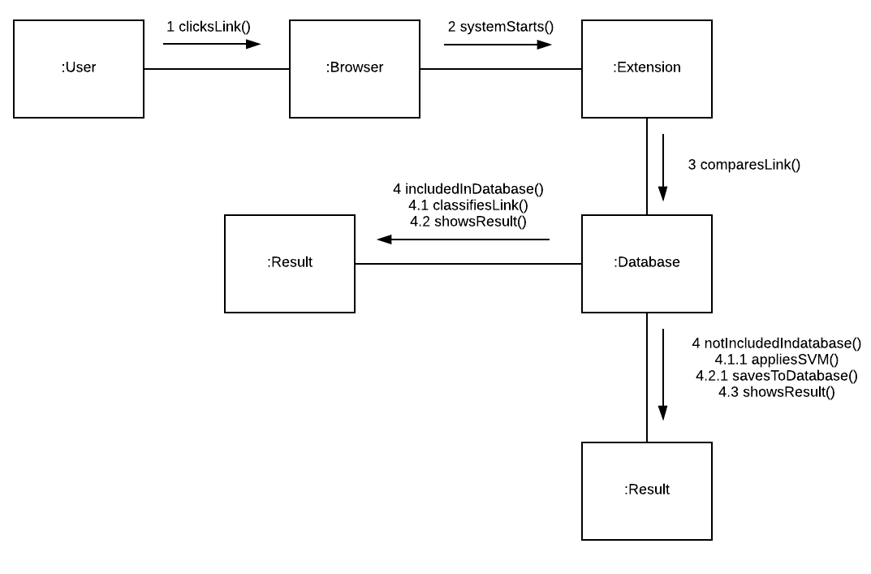
Communication Diagram

Slide 26
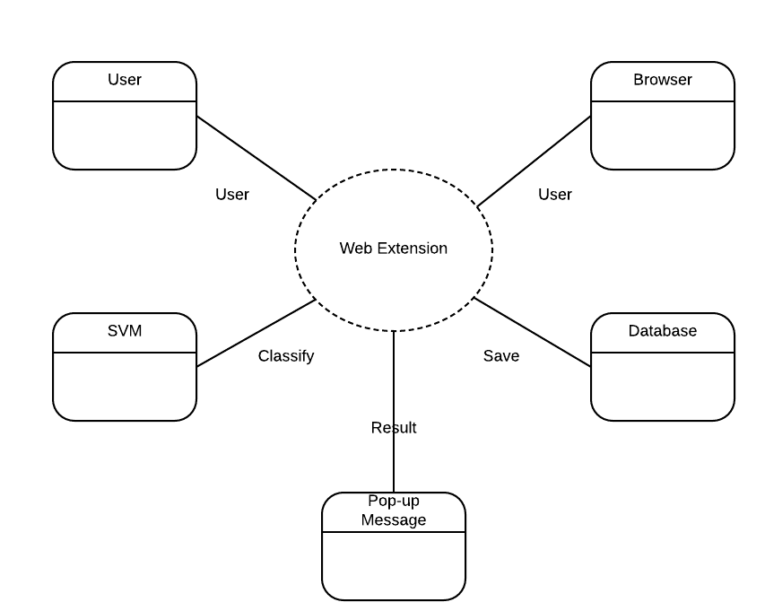
Composite Diagram

Slide 27
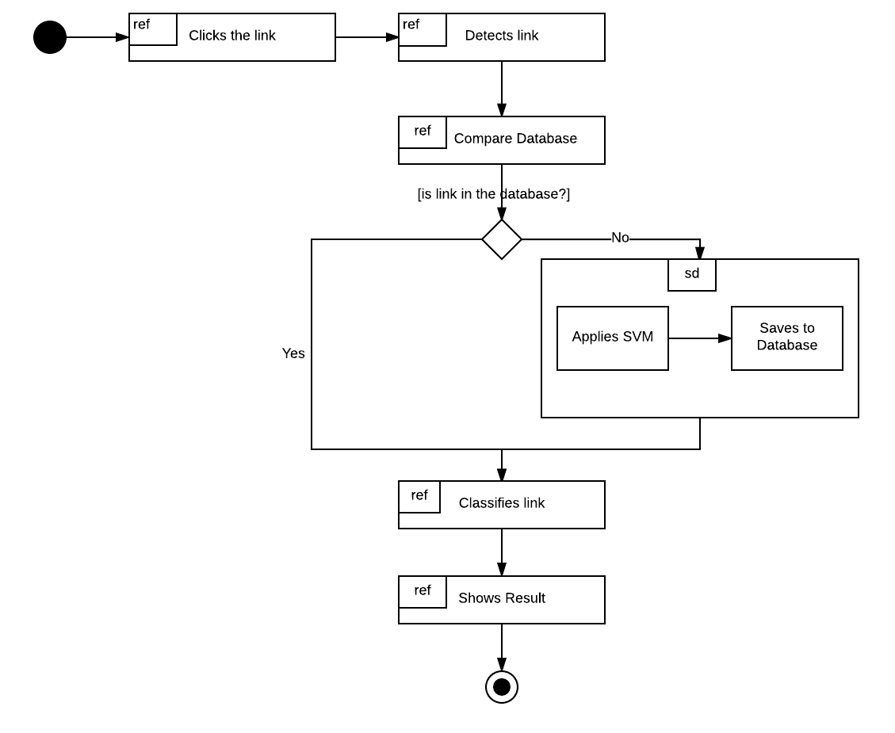
Interaction Overview Diagram

Slide 28
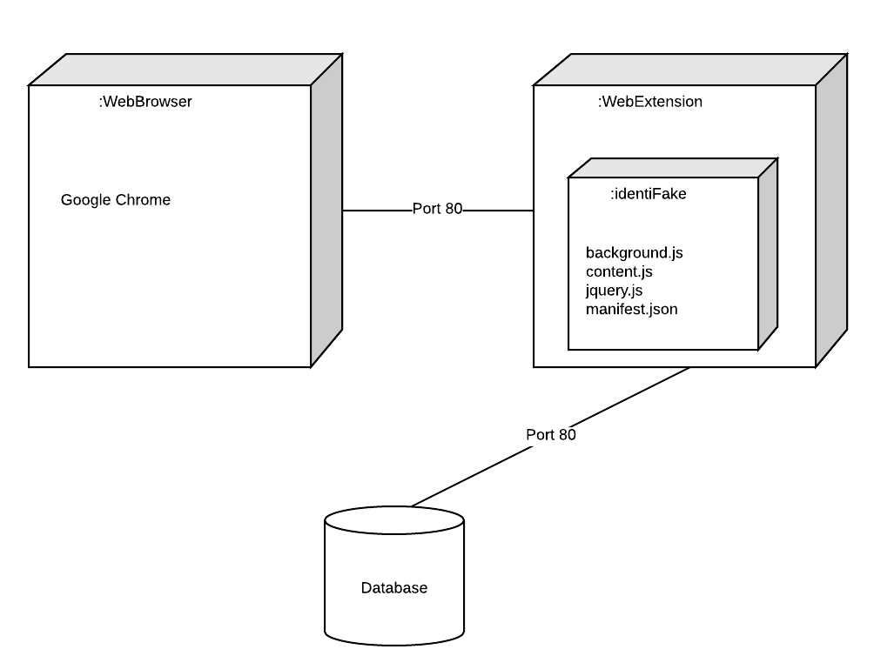
Deployment Diagram

Slide 29
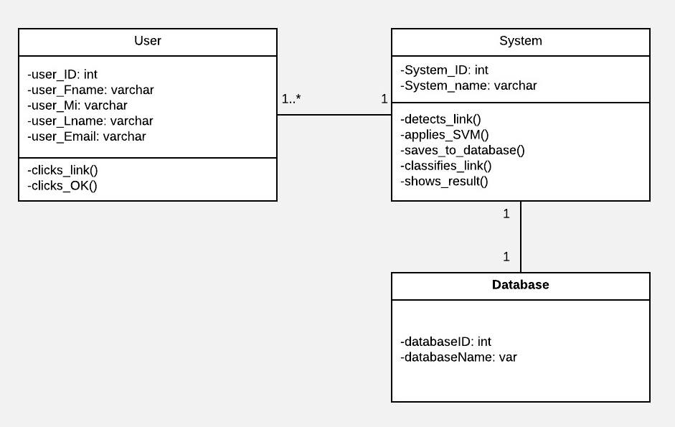
Class Diagram

Slide 30
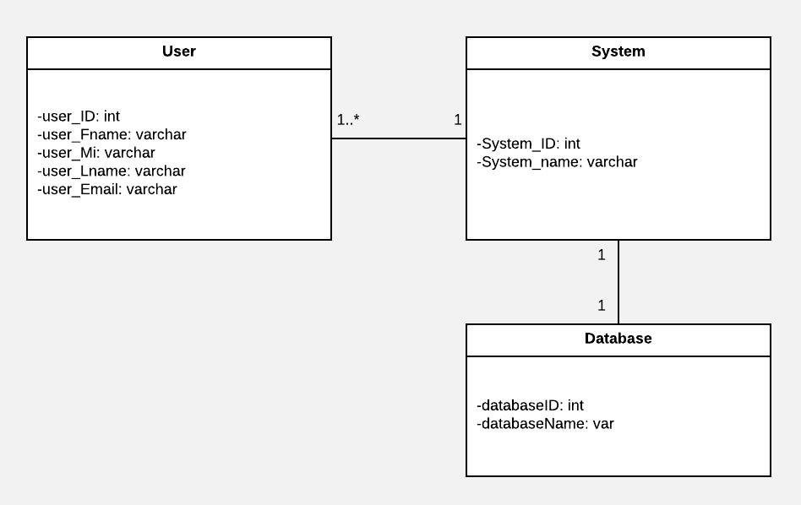
Object Diagram

Slide 31
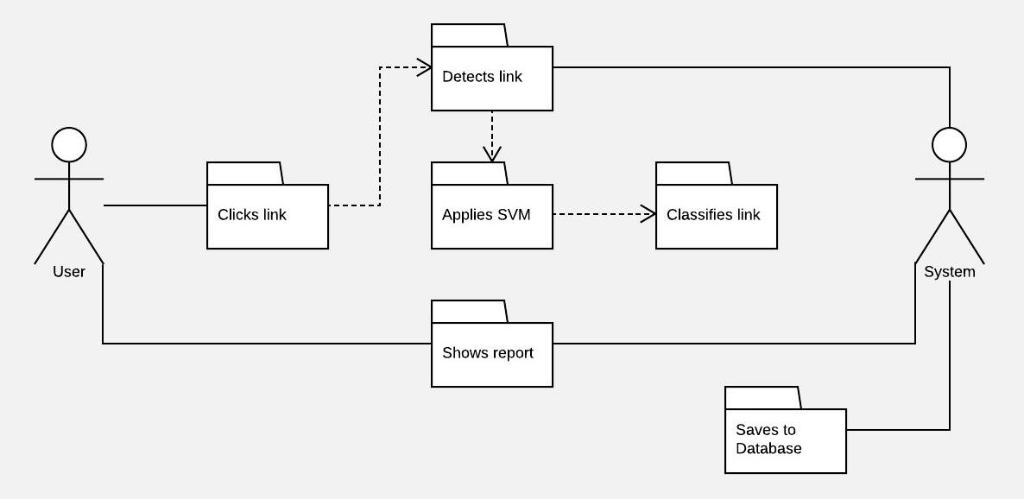
Package Diagram

Slide 32
Conclusion and Recommendation
Fake news can be lessened or better yet eliminated, since people keep falling prey for such posts; it needs to be stopped. This paper is meant to do just that; the program we are proposing is meant to detect if the news posted in your social media websites, which would literally get marked as a fake if it is one. To identify a fake news one must check the author, URL, title, number of likes, number of shares and number of comments. This program will be a plugin for the users’ internet browsers, but will only work for Facebook, and will not detect if posted news are fake from other websites. If this program could be implemented, there will definitely be a big change in how news would be spread, since users will no longer fall for faulty news articles and posts.

